Slide 1
Pacemaker Demo on Leon3
UCInspire Program
Han Wang

Slide 2
My work:
Understood the basic concept and working principle of the pacemaker by reading the VHDL, C code, and some reference.
Translated the hardware pcores to software code.
Set the communication between the board and PC by using TCP/IP module and Socket programming.
Developed a MATLAB GUI.

Slide 3
My work:
Understood the basic concept and working principle of the pacemaker by reading the VHDL, C code, and some reference.
Translated the hardware pcores to software code.
Set the communication between the board and PC by using TCP/IP module and Socket programming.
Developed a MATLAB GUI for doctoral configuration.

Slide 4
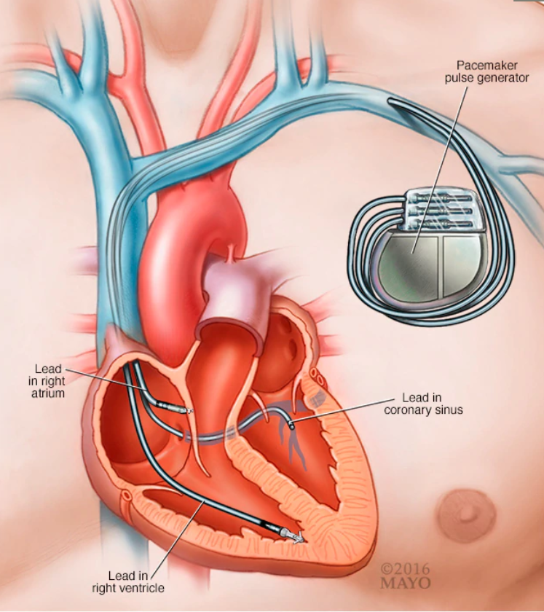
Introduction
Pacemaker is a small device with two parts — a generator and wires (leads, or electrodes) — that's placed under the skin in your chest to help control your heartbeat.
Normal heart beat: 60-100 /min
Pacemakers would maintain your normal
heart beat.
Notes:
Normal heart beat is of paramount importance
先介绍心脏：The beating of the heart can be divided into two processes
电信号：electric signal trigger one heart beat

Slide 5
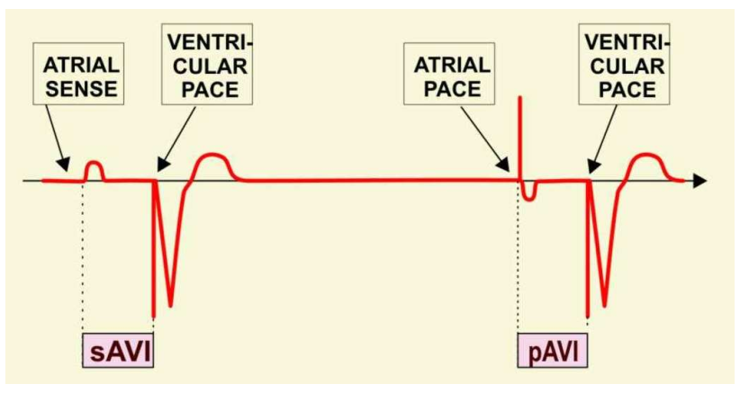
Basic concept of pacemaker programming
Atrial-Ventricular Interval (AVI):
The AVI is the time interval between an atrial paced or sensed event, and the delivery of a ventricular pacing stimulus.
Notes:
电信号：electric signal trigger one heart beat

Slide 6
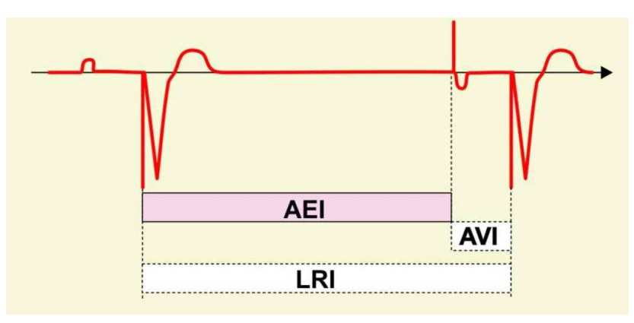
Basic concept of pacemaker programming
Atrial Escape Interval (AEI) or Ventricular-atrial interval (VAI):
The AEI is the time period from a ventricular event (intrinsic or paced) to an atrial pace.
Notes:
电信号：electric signal trigger one heart beat

Slide 7
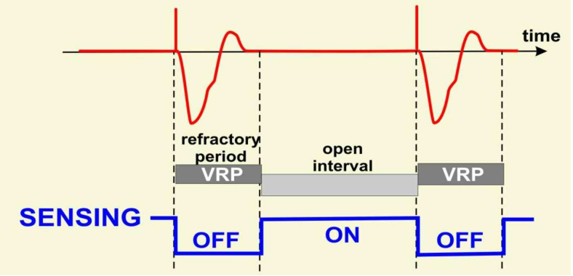
Basic concept of pacemaker programming
Ventricular Refractory Period (VRP):
VRP is the time interval following a ventricular event (sensed or paced) during which signals in the ventricle are not sensed.
Notes:
电信号：electric signal trigger one heart beat

Slide 8
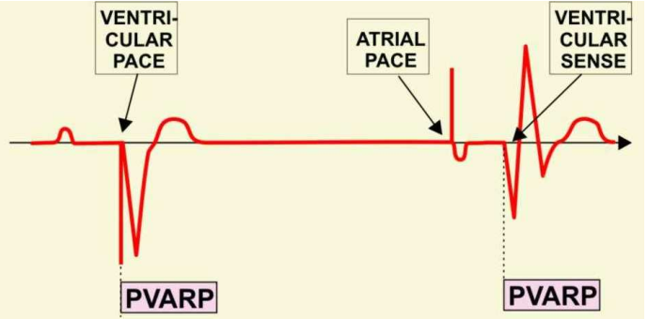
Basic concept of pacemaker programming
Post Ventricular Atrial Refractory Period (PVARP):
PVARP is the time interval following a ventricular event (sensed or paced) during which signals in the atrium are not sensed
Notes:
电信号：electric signal trigger one heart beat

Slide 9
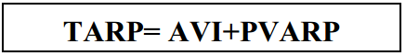
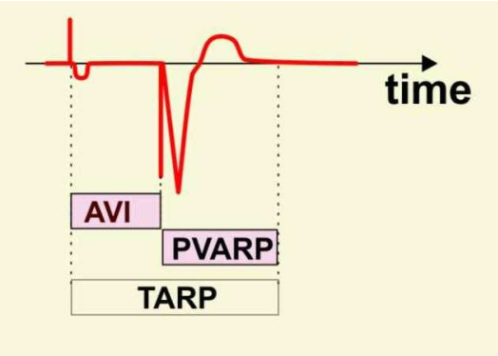
Basic concept of pacemaker programming
Total Atrial Refractory Period (TARP):
AVI and PVARP together form the Total Atrial Refractory Period.
Notes:
电信号：electric signal trigger one heart beat

Slide 10
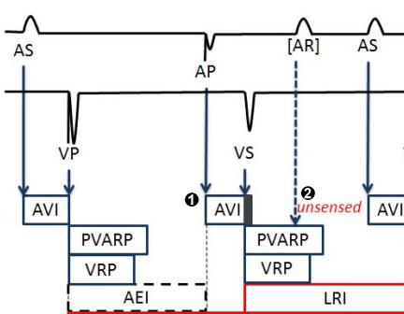
Working Principle
Atrium
Ventricle
VAI
VAI
VAI
Notes:
Timer overflow

Slide 11
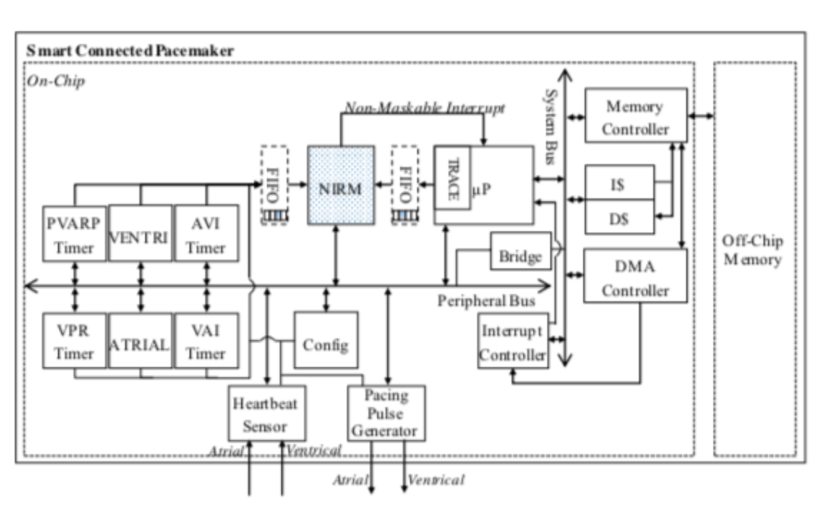
Notes:
Structure of the pacemaker
Works sync

Slide 12
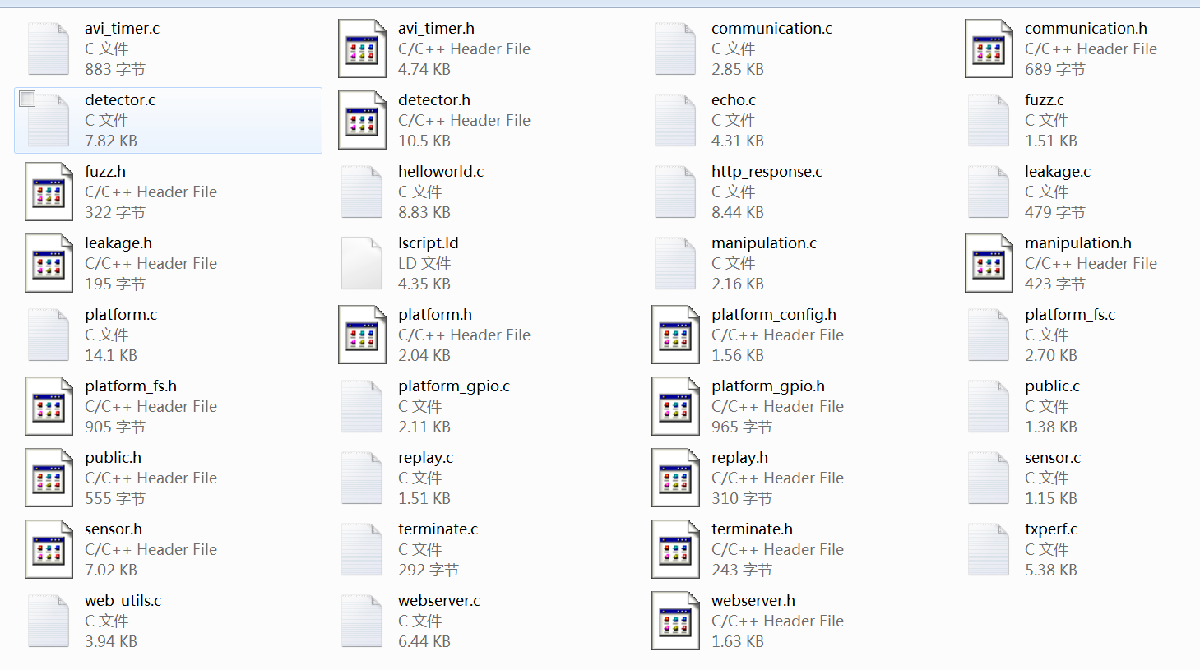
Original C code

Slide 13
Original C code

Slide 14
Original C code

Slide 15
Original C code

Slide 16
Original C code

Slide 17
Functions
Monitor the patience’s heart beat
Sense the atrial and ventricular beat
Generate the atrial or ventricular beat
Record the heart beat history data
Communication
Be configurable
And more…

Slide 18
My work:
Understood the basic concept and working principle of the pacemaker by reading the VHDL, C code, and some reference.
Translated the hardware pcores to software code.
Set the communication between the board and PC by using TCP/IP module and Socket programming.
Developed a MATLAB GUI for doctoral configuration.

Slide 19
POSIX Thread
Can not run in parallel
Runs in parallel
Has very good portability
Function()
Do some work
VS
pthread_creat()
Do some work
Function
Muti-thread

Slide 20
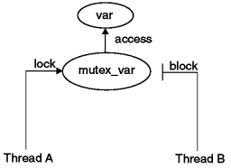
How could threads get synchronization?
Mutexes
Conditional variable
Thread A
Thread B
Lock
Wait
Lock
Conditional
variable
Signal
unlock
unlock
Notes:
Crucial area

Slide 23
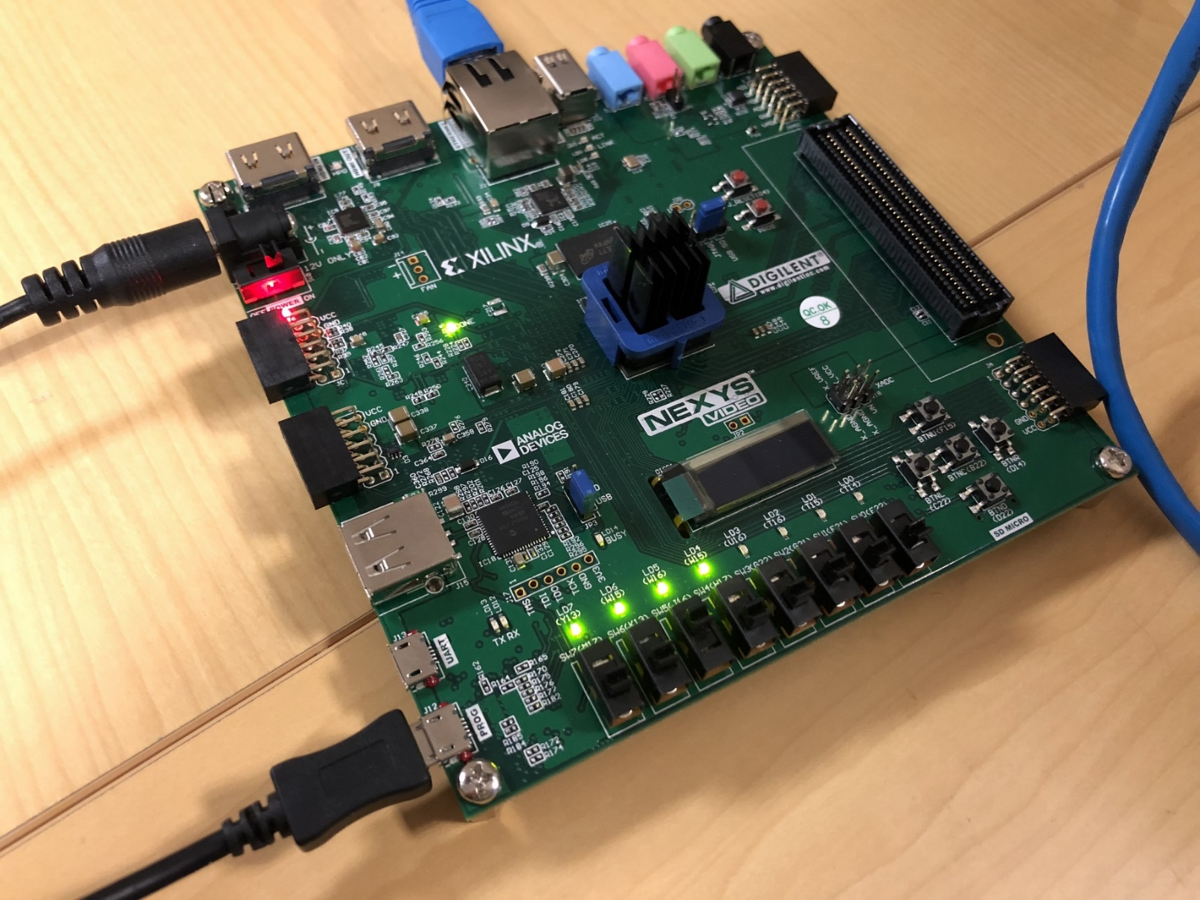
Platform
LEON3 Processor
+
RTEMS
RTEMS: real-time operation system
Designed for real-time, embedded systems and to support various open API standards including POSIX
Architectures: ARM, Freescale Cold Fire, DSPs, LEON

Slide 24
My work:
Understood the basic concept and working principle of the pacemaker by reading the VHDL, C code, and some reference.
Translated the hardware pcores to software code.
Set the communication between the board and PC by using TCP/IP module and Socket programming.
Developed a MATLAB GUI for doctoral configuration.

Slide 25
Communication method selection
Programming
UART
Build-in JTAG
Data transmission
UART
Ethernet

Slide 26
Communication method selection
Programming
UART
Build-in JTAG
Data transmission
UART
Ethernet

Slide 27
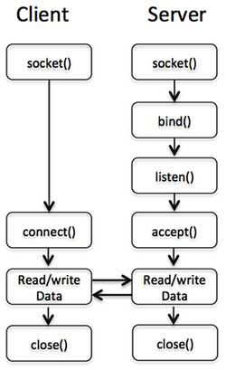

Ethernet
Fast
TCP/IP
Reliable
Socket Programming
Easy to use

Slide 29
Some Problems:
1) The number of bits transferred must be determined, but VAI, AVI and heart rate could have different number of digits
e.g. AVI could be 120ms or 90ms
Solution:
120 ‘120’, 90 ’990’
2) It is not a Full Duplex communication. How to receive command from the client during the transfer process and how to determine the right order of the data?
Solution:
Use a token to make it in good order.

Slide 30
Token Ring
Token=0
Receive the command
Comn thread
Receiving
VAI thread
Atrial thread
Token=3
Send heart rate
Token=1
Send VAI
Sending
AVI thread
Token=2
Send AVI

Slide 31
My work:
Understood the basic concept and working principle of the pacemaker by reading the VHDL, C code, and some reference.
Translated the hardware pcores to software code.
Set the communication between the board and PC by using TCP/IP module and Socket programming.
Developed a MATLAB GUI for doctoral configuration.

Slide 32
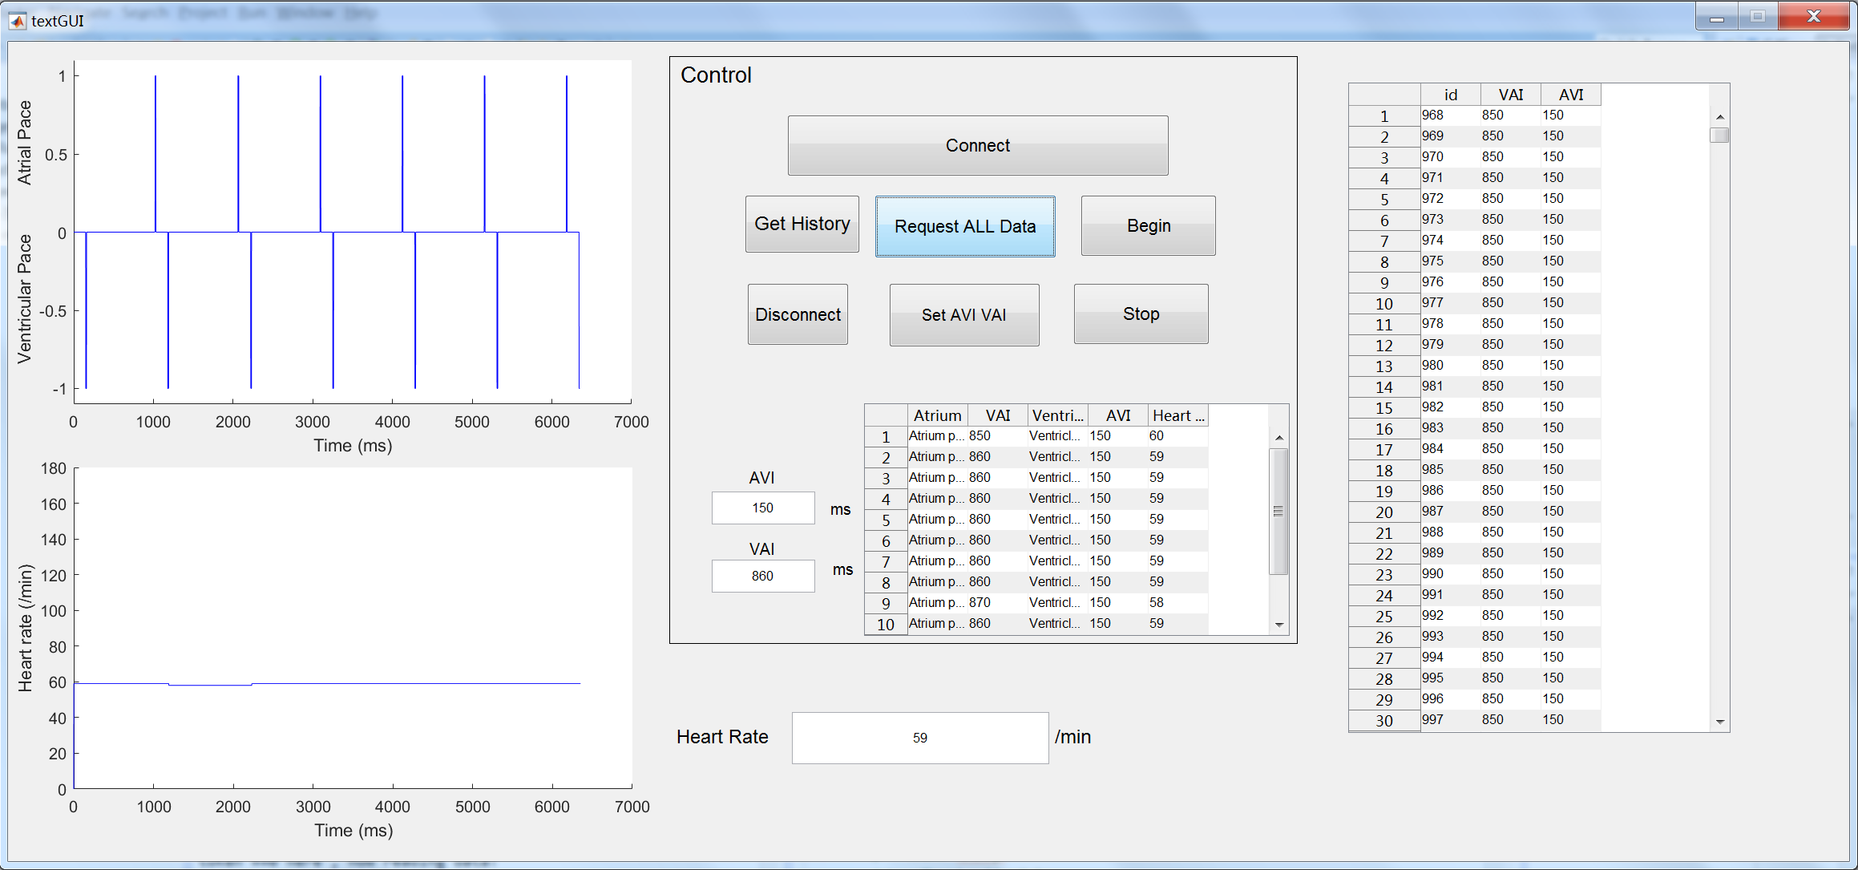
Matlab GUI

Slide 33
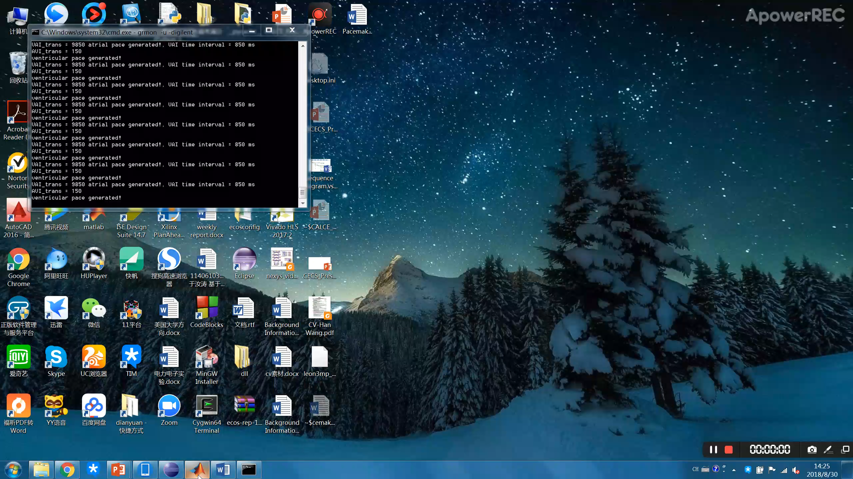

Slide 34
My gains:
Experienced doing research in the United States
Gradually adapted to independent life in a unfamiliar environment
Met many outstanding people and known different field of study
Strengthened the determination of studying in the United States

Slide 35
Special Thanks to
Prof. Fadi Kurdahi
And
Dr. Minjun Seo

